Slide 1
AI Powered Phishing Attack Detection
Joyail Tokas and Jennifer Valencia
July 29, 2024

Slide 2
Introduction
Problem statement
Business needs
Objectives
Exploratory Data Analysis
Feature Importance
Machine-Learning Models
Streamlit Applications
Conclusions & Future Recommendations

Slide 3
Problem Statement
Phishing is a type of anomaly that consists of malicious attacks intended to trick people into divulging sensitive information (Justindhas et. al., 2023). They are frequently formatted as URLs that mimic legitimate websites. Failure to identify these attacks can result in significant repercussions, such as identity theft, malware distribution, financial threats, and security breaches.

Slide 4
Business Needs
Research shows evidence of an increase in phishing attacks in recent years (Alkhalil et. al., 2021). With the rise of phishing attacks, it is essential for businesses to be equipped with robust tools needed to recognize these threats efficiently. Phishing can have detrimental effects on both individual and organizational scales. Unfortunately, these deceptive threats are not easily detected by the human eye, especially as they become more sophisticated. As a result, machine learning must be employed to identify these anomalies quickly and accurately and mitigate potential harm. K-Means Clustering, DBSCAN, Support Vector Machine, and LDA are machine learning approaches that can be used for phishing detection.

Slide 5
Objective
This project will incorporate machine learning algorithms to identify potential phishing attempts through deceptive URLs. Some approaches to be explored include K-Means Clustering, DBSCAN, Support Vector Machine, and LDA. The models will be trained and tested using the PhiUSIIL Phishing URL Dataset from UC Irvine Machine Learning Repository, which comprises 134,850 legitimate and 100,945 phishing URLs. The performance of each of the models will be evaluated to determine which one achieves the highest accuracy when distinguishing between legitimate and illegitimate URLs.
Notes:
Update: Focus on LDA rather than Deep Learning

Slide 6
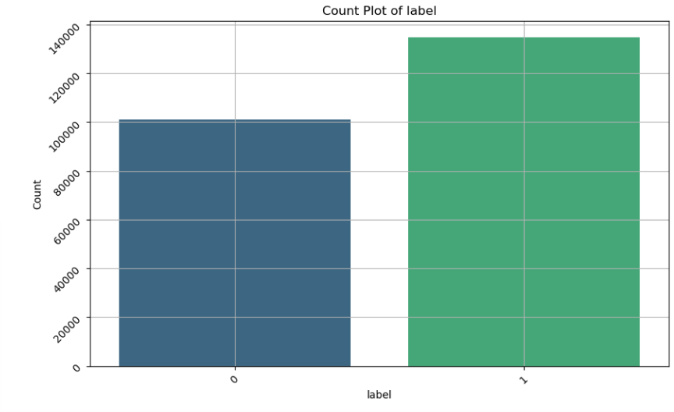
Exploratory Data Analysis
The distribution of the dataset was plotted using a bar graph and pie chart. The feature Label identifies whether or not a URL is phishing (0) or legitimate (1). The dataset comprises 134,850 legitimate and 100,945 phishing URLs
Notes:
jtokas29/Phishing_Attacks_Detection

Slide 7
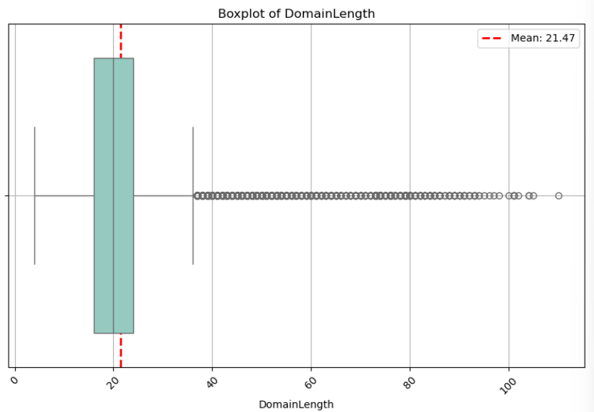
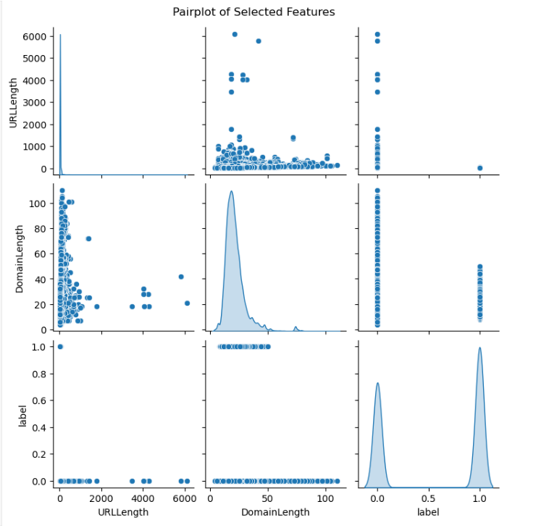
Exploratory Data Analysis
To understand the relationship between the variables, a correlation matrix was plotted. A box plot of the DomainLength feature was plotted, and the mean was found to be 21.47. A pairplot of the features Label, DomainLength, and URL length was also plotted.

Slide 8
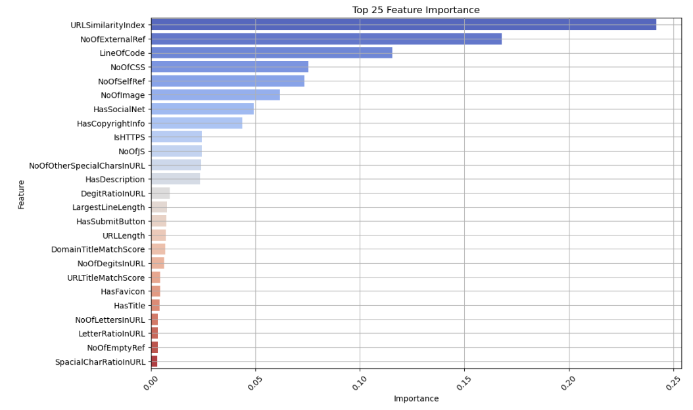
Feature Importance
Notes:
The dataset was pre-processed. Non-numeric columns were dropped from the DataFrame, null values were accounted for, and categorical columns were encoded using LabelEncoder().
As mentioned previously, the dataset includes 56 features to describe the data. Feature importance was calculated using RandomForestClassifier() and was plotted. Pre-processing revealed that there are 25 meaningful features in the dataset that correlate with Label.
In our original analysis, we had taken the top 15 most important features. But further pre-processing revealed there were 25 meaningful features.

Slide 9
Domain Name Scoring Mechanism
To enrich the dataset with a Domain Name Scoring System, a combination of third-party libraries and APIs was used to provide security scores for domains.
The required libraries were installed and API keys for third party services were set up. A function was created to take a domain, query the APIs, and return a safety score based on the responses.
After loading the initial dataset, the domain column was extracted to compute the domain score. The DataFrame will be updated to display the domain scores for each URL.
Due to the costs of Hunter API (~$500 per month), the scoring mechanism is recommended for future updates to this project.

Slide 10
Model Results
Machine Learning Model | Testing Accuracy | Silhouette Score
K-Means Clustering | - | 0.31
SVM | 99.98% | -
DBSCAN | - | -0.18
LDA | 99.85% | -

Slide 11
Additional Model Evaluation Metrics
To improve the evaluation of our phishing URL detection model by incorporating additional metrics, we added some enhancing Model Evaluation
Mean Squared Error (MSE): Measures the average squared difference between actual and predicted values. It is used primarily for regression tasks.
Root Squared Error (RSE): Square root of MSE. It provides an error metric in the same units as the original data, making it easier to interpret.
Mean Average Precision (MAP): Used to evaluate the precision of a model in ranking problems, particularly in information retrieval tasks.
F1 Score: The harmonic mean of precision and recall. It is used to balance precision and recall in classification tasks.

Slide 12
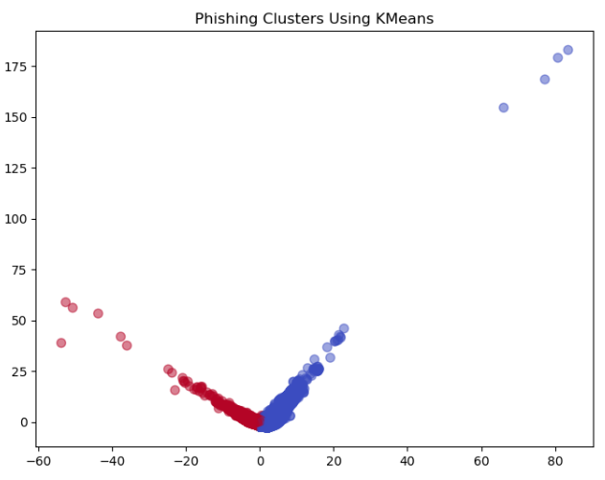
K-Means Clustering
The necessary libraries from sklearn were imported.
K-Means Clustering is an unsupervised machine learning algorithm. Therefore, the label feature was dropped from the DataFrame.
The data was scaled using StandardScaler(), and then split into training and testing dataset.
The number of clusters was determined to be 2 since the classification of phishing is a binary issue, either being phishing or legitimate.
To reduce dimensionality, principal component analysis (PCA) was employed.
The silhouette score = 0.31

Slide 13
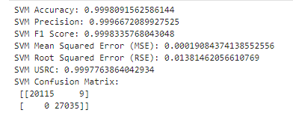
Support Vector Machine
The necessary libraries were imported from sklearn to create the SVM model. The X and y variables were defined, with the former being the DataFrame and the latter being the label column. The data was split into training and testing datasets, and was scaled. The model was tested using the training data. Afterwards, the performance of the model was evaluated using the testing data. The accuracy was found to be 99.98%.

Slide 14
DBSCAN
Methodology:
Applied the k-nearest neighbors algorithm to determine the optimal value for eps using the elbow method.
Set eps and min_samples based on the k-distance graph.
Applied DBSCAN clustering algorithm to the scaled training data.
Visualized the clusters using PCA.
Calculated the silhouette score to evaluate the clustering performance.
Result:
Optimal eps Determination: Used the k-distance graph to identify the elbow point.
Clustering Visualization: Plotted the clusters using PCA, indicating distinct cluster formation.
Silhouette Score: Achieved a silhouette score of -0.18.

Slide 15
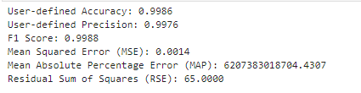
LDA
Methodology:
Filtered out non-numeric columns to ensure LDA compatibility.
Split the dataset into training and testing sets with only numerical columns.
Trained the LDA model on the training data.
Predicted and evaluated the performance on the test data using accuracy, confusion matrix, and classification report.
Model Training:
Successfully trained the LDA model on the numerical features.
Model Evaluation:
Accuracy: Achieved an accuracy score of 0.87 on the test set.
Confusion Matrix: Displayed the confusion matrix to understand the classification distribution.
Classification Report: Provided precision, recall, and F1-score for a detailed performance analysis.

Slide 16
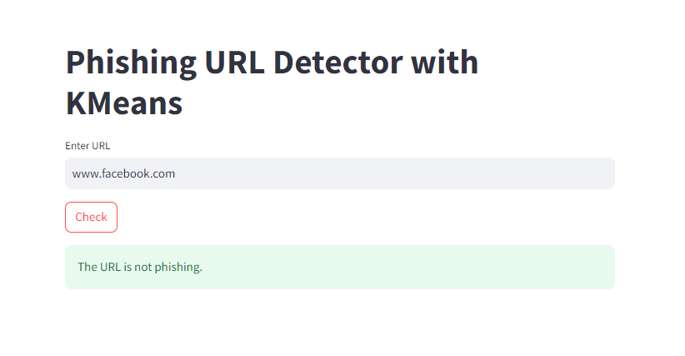
StreamLit Applications
Streamlit applications were created based on the KMeans, LDA, and SVM models
The models were saved as pickle files
The code loads the model from the pickle library, accepts a URL input, transforms it using the vectorizer, and predicts whether or not a URL is phishing.
Notes:
Streamlit run LDA_Streamlit.py

Slide 17
Conclusion and Future Recommendations
Based on the various metrics, SVM, DBSCAN, K-Means Clustering, and LDA are successful models for determining whether or not a URL is phishing
Due to the cost of Hunter API (~$500/month), the scoring mechanism was not pursued. However, the code remains in this project for potential future updates of this project.

Slide 18
References
Justindhas, Y., Raghul, V., Pramadeish S., Prakash, S.. (2024). A Comprehensive review on An Ensemble-Based Machine Learning Approach for Phishing Website Detection. In 2024 2nd International Conference on Computer, Communication and Control (IC4), 1-6, https://ieeexplore.ieee.org/document/10486561
Prasad,Arvind and Chandra,Shalini. (2024). PhiUSIIL Phishing URL (Website). UCI Machine Learning Repository. https://doi.org/10.1016/j.cose.2023.103545.
Althobaiti, K., Wolters, M.K., Nawal, A., Vaniea, K. (2023, August 31). Using Clustering Algorithms to Automatically Identify Phishing Campaigns. IEEE Access, 11, 96502-96513. doi: 10.1109/ACCESS.2023.3310810
Alkhalil, Z., Hawage, C., Nawaf, L., Khan, I. (2021, March 9). Phishing Attacks: A Recent Comprehensive Study and a New Autonomy. Frontiers in Computer Science 3:563060. doi: 10.3389/fcomp.2021.563060
Catal, C., Giray, G., Tekinerdogan, B., Kumar, S., Shukla, S. (2022, May 23). Applications of Deep Learning for Phishing Detection: A Systematic Literature Review. Knowledge and Information Systems, 64, 1457-1500. https://doi.org/10.1007/s10115-022-01672-x
Sahu, K. & Shrivastava, S.K. (2015, February). Kernel K-Means Clustering for Phishing Website and Malware Categorization. International Journal of Computer Applications 111(9).
Sindhu, S., Patil, S.P., Sreevalsan, A., & Rahman, F. (2020). Phishing Detection Using Random Forest, SVM, and Neural Network with Backpropagation. 2020 International Conference on Smart Technologies in Computing, Electrical, and Electronics (ICSTCEE), 391-394. doi: 10.1109/ICSTCEE49637.2020.9277256

